Slide 1
Qt编程 实验目录
1.实验内容
2.实验目的
3.实验平台
4.程序完成指标
5.实验参考
6.实验步骤
7.参考程序
8.思考题

Slide 2
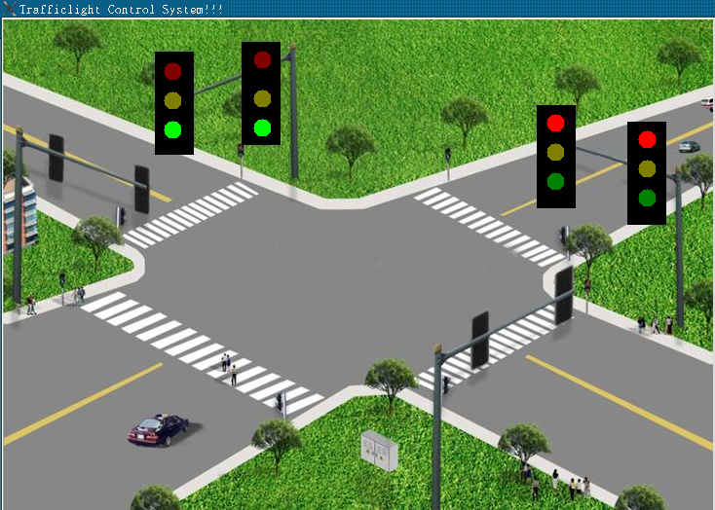
Qt编程 一、实验内容
编写Qt程序，仿真交叉路口交通灯运行情况，如图,
要求：
(1)交叉路口为2道4路口设置,为南北、东西方向。
(2)信号灯变换过程为
a).南北，绿灯，30秒；东西红灯，30秒；
b).南北、东西时间到，过度到黄灯，4秒；
c).南北，红灯，30秒；东西绿灯，30秒；
d).南北、东西时间到，过度到黄灯，4秒；
一直按照以上顺序运行
(2)程序在FS6818M4实验箱上运行

Slide 3
Qt编程 二、实验目的
1.学习掌握图像显示方法和编程技巧。
2.Timer的编程方法和调试技巧。
3.学习掌握绘画的编程方法和调试技巧。

Slide 4
Qt编程 三、实验平台
1.硬件
计算机 1台
FS_6818M4_V2实验箱 1台
2.软件
(1)台式计算机
操作系统： Windows10
虚拟机: VMware-player-15.1.0
Ubuntu18.04
ubuntu-18.04-64bit_farsight(包含Qt,ARM-Qt)
超级终端：PUTTY.EXE
(2) FS_6818M4_V2实验箱
嵌入式Linux操作系统

Slide 5
Qt编程 四、实验完成指标
运行程序，
显示交叉路口交通灯仿真运行图

Slide 6
Qt编程 五、实验参考
交通灯运行原理
(1)加载背景图片
QImage loadImage;
if (loadImage.load(“main.jpg”)) //加载图片
{
image=loadImage;
QSize newSize=loadImage.size().expandedTo(size()); //获取图片大小
resizeImage(&loadImage,newSize); //绘图区域重设指定的宽、高
update(); //调用:paintEvent()函数，重绘窗口
}
(2)设置定时器，价格1秒，时间到运行go()槽函数
QTimer *timer=new QTimer(this); //定义初始化Qtimer对象
connect(timer,SIGNAL(timeout()),SLOT(go())); //定时到，产生信号timeout(),调用槽函数go()
timer->start(1000); //启动定时器，间隔1秒

Slide 7
Qt编程 五、实验参考
(3) go()函数
将交通灯变换定义为n步，依据nStep=0、1、2、…n-1，每一步有自己的初始时间nTime,执行一次go(),nTime减1，直到减到0，变换到下一步.
同时，执行一次update()函数，调用paintEvent()函数，重回窗口
(4)重绘窗口
依据nStep判定当前交通信号灯显示情况，用以下语句段绘制交通等变换图，
painter.setPen(QPen(Qt::black,Qt::DashLine)); //黑色，
painter.setBrush(QBrush(Qt::darkRed,Qt::SolidPattern));//暗红
painter.drawEllipse(165,45,20,20); //在信号灯位置绘制圆

Slide 8
Qt编程 五、实验参考
2.交通灯绘制:红、暗红、绿、暗绿、黄、暗黄
painter.setPen(QPen(Qt::black,Qt::DashLine)); //黑色，
painter.setBrush(QBrush(Qt::darkRed,Qt::SolidPattern));
painter.drawEllipse(165,105,20,20); //黑红
painter.setBrush(QBrush(Qt::Red,Qt::SolidPattern));
painter.drawEllipse(165,105,20,20); //红
painter.setBrush(QBrush(Qt::darkYellow,Qt::SolidPattern));
painter.drawEllipse(165,105,20,20); //暗黄，
painter.setBrush(QBrush(Qt::Yellow,Qt::SolidPattern));
painter.drawEllipse(165,105,20,20); //黄，
painter.setBrush(QBrush(Qt::green,Qt::SolidPattern));
painter.drawEllipse(165,105,20,20); //绿色
painter.setBrush(QBrush(Qt::darkGreen,Qt::SolidPattern));
painter.drawEllipse(165,105,20,20); //暗绿

Slide 9
Qt编程 五、实验参考
3.QTimer：定时器
(1)构造函数
QTimer(int interval,QObject *parent=nullptr)
(2)启动定时器
start(int msec=0);
(3)停止定时器
stop();
(4)设定计时间隔
setInterval(int interval);
(5)设定计时方式
setSingleShot(bool singleShot)
singleShot=true ;定时到时停止。
singleShot=false;定时到时，启动下一次定时

Slide 10
Qt编程 五、实验参考
(6)返回定时器标识符
unsigned int timerId()const;
(7)返回计时器状态
Bool isActive();
(8)示例:
QTimer *timer = new QTimer(this);
connect(timer, SIGNAL(timeout()), this, SLOT(update()));
//定时到timeout(),执行槽update()
timer->start(1000); //启动定时器，间隔1S

Slide 11
Qt编程 五、实验参考
4. paintEvent(QPaintEvent *)
(1)为QWidget的虚函数，用于绘制UI界面.
(2)运行时机：
窗口变更；
执行repaint()或update()函数

Slide 12
Qt编程 五、实验参考
5. QColor：
(1)描述颜色的属性类，提供更多的颜色选择,Qt::red Qt::yellow Qt::blue
(2)构造函数 QColor(QColor &color);
6. QPainter
(1)QPainter 是用于执行绘图操作的类。
QPaintDevice 表示可以使用 QPainter 在其上绘图。
QPaintEngine 提供了一个接口(绘图引擎)，QPainter 可以使用QPaintEngine在不同类型的设备上绘图
(2)构造函数
QPainter(QPaintDevice *device)
构造函数自动调用 begin()，析构函数自动调用 end()。
例如:
QPainter painter;
painter.begin(this);
painter.drawLine(...);
painter.end();
等同于以下代码
QPainter p(this);
p.drawLine(...);

Slide 13
Qt编程 五、实验参考
(3) bool begin(QPaintDevice *device)
开始绘制绘画设备，成功,返回true;失败,返回false。
(4) setRenderHint
抗锯齿是计算机图形学中的常用技术，用于平滑图形边缘，使其看起来更加自然，避免了边缘的锯齿状。setRenderHint()函数设置QPainter::Antialiasing渲染提示可以使图形更加平滑自然。
void QPainter::setRenderHint(QPainter::RenderHint hint, bool on = true)
(5)translate
坐标系统平移
void translate(qreal dx,qreal dy);
将坐标系统水平移动dx;垂直移动dy
(6) Rotate
void rotate(qreal angle);
将坐标系统按原点顺时针旋转angle角度
(7) scale
Void scale（qreal sx,qreal sy);
sx：x方向的缩放比例； sy：y方向的缩放比例
缩放比例>1,图像放大； 缩放比例<1,图像缩小.

Slide 14
Qt编程 五、实验参考
(8) setPen： 设置画笔
(9)setBrush(hourColor)：设置画刷
(10) save(): 将绘图状态（坐标转换参数、画笔、画刷参数）保存到堆栈中
使用restore函数恢复.
(11）drawConvexPolygon:根据给定的点画凸多边行
(12) restore(); 恢复绘画状态
(13) drawLine：画线
(14)drawRect():绘制矩形
(15)drawRoundedRect():绘制圆角矩形

Slide 15
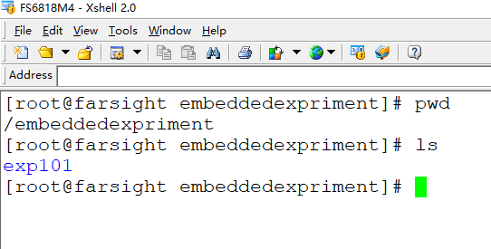
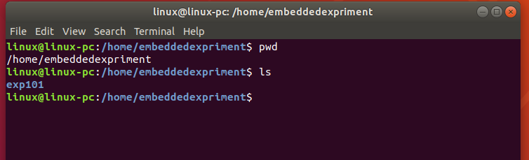
Qt编程 六、实验步骤
1.确认编程环境准备好
(1).确认VM ubuntu18.04已经启动
(2).确认实验箱已经启动
如果没有准备好，参考实验1.1，
安装实验1.1步骤启动ubuntu18.04和实验箱

Slide 16
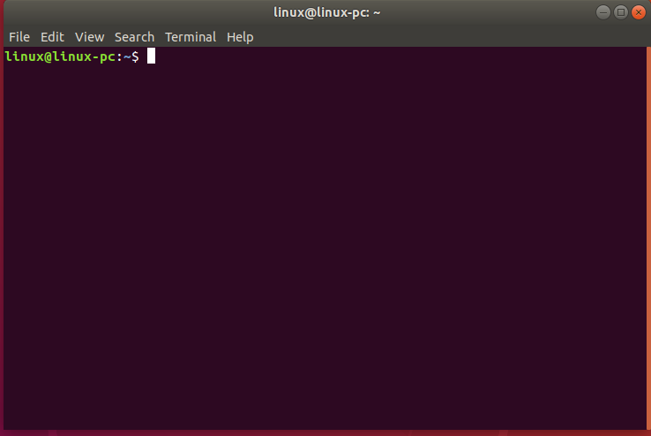
Qt编程 六、实验步骤
2.ubuntu18.04下，进入“终端”,如果已经进入，略过此步,
在ubuntu18.04操作主窗口，按组合键CTRL+ALT+T,进入终端窗口

Slide 17
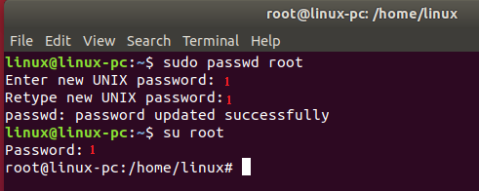
Qt编程 六、实验步骤
3.切换到root,如果已经进入root，略过此步,
linux@linux-pc:~$ sudo passwd root
Enter new UNIX password: 1
Retype new UNIX password: 1
passwd: password updated successfully
linux@linux-pc:~$ su root
Password: 1
root@linux-pc:/home/linux#

Slide 18
Qt编程 六、实验步骤
4.编程
(1)进入 /home/embeddedexpriment目录
(2)创建实验4的第3个小实验实验目录exp403
# mkdir exp403
# cd exp403
# pwd
/home/embeddedexpriment/exp403

Slide 19
Qt编程 六、实验步骤
(3)在exp403下编写程序
root@linux-pc:/home/embeddedexpriment/exp403# vim mainwindow.h
root@linux-pc:/home/embeddedexpriment/exp403# vim mainwindow.cpp
root@linux-pc:/home/embeddedexpriment/exp403# vim trafficlight.h
root@linux-pc:/home/embeddedexpriment/exp403# vim trafficlight.cpp
root@linux-pc:/home/embeddedexpriment/exp403# vim main.cpp
root@linux-pc:/home/embeddedexpriment/exp403# ls
trafficlight.cpp trafficlight.h mainwindow.cpp
mainwindow.h main.cpp
root@linux-pc:/home/embeddedexpriment/exp403#

Slide 20
Qt编程 六、实验步骤
(4)将准备好的交叉路口仿真图片拷到exp403下
root@linux-pc:/home/embeddedexpriment/exp403#cp /mnt/hgfs/ushare/exp403/main.jpg ./
trafficlight.cpp trafficlight.h mainwindow.cpp
mainwindow.h main.cpp main.jpg
root@linux-pc:/home/embeddedexpriment/exp403#

Slide 21
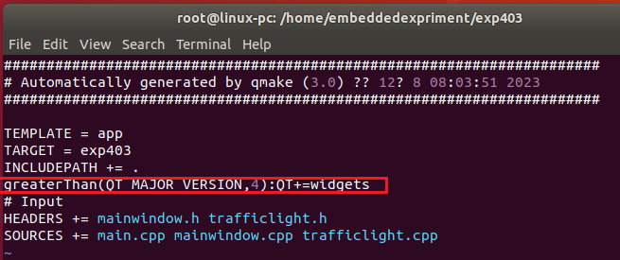
Qt编程 六、实验步骤
(5)使用qmake生成exp403.pro、Makefile,并对exp403.pro修改
/exp403# ls
main.jpg trafficlight.cpp trafficlight.h
mainwindow.cpp mainwindow.h main.cpp
/exp403# /opt/qt/bin/qmake -project
/exp403# /opt/qt/bin/qmake
/exp403#ls
main.jpg Makefile trafficlight.cpp trafficlight.h
mainwindow.cpp exp403.pro mainwindow.h main.cpp
/exp403# vim exp403.pro
/exp403#

Slide 22
Qt编程 六、实验步骤
5.编译、链接
root@linux-pc:/home/embeddedexpriment/exp403# ls
main.jpg Makefile trafficlight.cpp trafficlight.h
mainwindow.cpp exp403.pro mainwindow.h main.cpp
root@linux-pc:/home/embeddedexpriment/exp403# vim exp403.pro
root@linux-pc:/home/embeddedexpriment/exp403# make
root@linux-pc:/home/embeddedexpriment/exp403# ls
autoexec main.jpg Makefile trafficlight.cpp
clsfile main.o moc_mainwindow.cpp trafficlight.h
exp403 mainwindow.cpp moc_mainwindow.o trafficlight.o
exp403.pro mainwindow.h moc_trafficlight.cpp
main.cpp mainwindow.o moc_trafficlight.o
root@linux-pc:/home/embeddedexpriment/exp403#

Slide 23
Qt编程 六、实验步骤
6.exp403拷贝到/sources/rootfs/embeddedexpriment
root@linux-pc:/home/embeddedexpriment/exp403# cd /source/rootfs/embeddedexpriment/
root@linux-pc:/source/rootfs/embeddedexpriment/#cp –rf /home/embeddedexpriment/exp403/ ./
root@linux-pc:/source/rootfs/embeddedexpriment# ls
exp101 exp103 exp202 exp301 exp3021 exp401 exp403
exp102 exp201 exp203 exp302 exp303 exp402 expt101
root@linux-pc:/source/rootfs/embeddedexpriment#

Slide 24
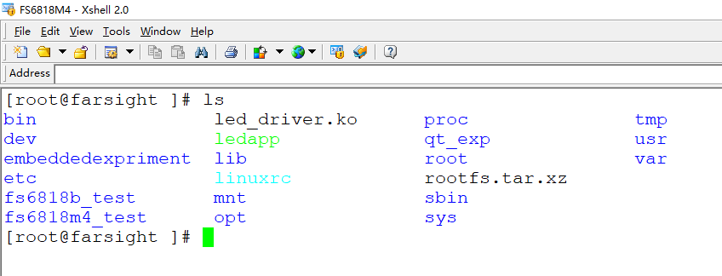
Qt编程 六、实验步骤
7.运行程序
(1)激活fs6818M4会话窗口,进入exp403目录

Slide 25
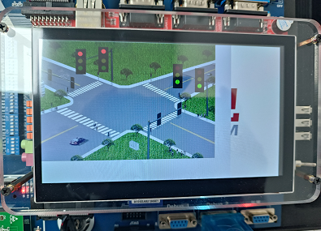
Qt编程 六、实验步骤
(2)执行程序
[root@farsight ]# ls
bin led_driver.ko proc tmp
dev ledapp qt_exp usr
embeddedexpriment lib root var
etc linuxrc rootfs.tar.xz
fs6818b_test mnt sbin
fs6818m4_test opt sys
[root@farsight ]# cd embeddedexpriment/
[root@farsight embeddedexpriment]# ls
exp101 exp103 exp202 exp301 exp3021 exp401 exp402
exp102 exp201 exp203 exp302 exp303 exp403 expt101
[root@farsight embeddedexpriment]# cd exp403/
[root@farsight exp403]# ls
autoexec main.jpg Makefile trafficlight.cpp
clsfile main.o moc_mainwindow.cpp trafficlight.h
exp403 mainwindow.cpp moc_mainwindow.o trafficlight.o
exp403.pro mainwindow.h moc_trafficlight.cpp
main.cpp mainwindow.o moc_trafficlight.o
[root@farsight exp401]# ./exp403 -qws
[ 70.721000] <<-GTP-INFO->> System resume.
[ 70.729000] <<-GTP-INFO->> GTP wakeup sleep.

Slide 26
Qt编程 七、实验参考程序
1.main.cpp主程序
#include <QApplication>
#include "mainwindow.h"
int main(int argc,char *argv[])
{
QApplication app(argc,argv);
MainWindow window;
window.show();
return app.exec();
}

Slide 27
Qt编程 七、实验参考程序
2.exp403.pro工程文件
TEMPLATE = app
TARGET = exp403
INCLUDEPATH += .
greaterThan(QT_MAJOR_VERSION,4):QT+=widgets
# Input
HEADERS += mainwindow.h trafficlight.h
SOURCES += main.cpp mainwindow.cpp trafficlight.cpp

Slide 28
Qt编程 七、实验参考程序
3.mainwindow.h
#ifndef MAINWINDOW_H
#define MAINWINDOW_H
#include <QMainWindow>
class ShowArea;
class MainWindow:public QMainWindow
{
Q_OBJECT
public:
MainWindow();
private:
ShowArea *showArea;
};
#endif

Slide 29
Qt编程 七、实验参考程序
4. mainwindow. cpp
#include <QtGui>
#include "mainwindow.h"
#include "trafficlight.h"
MainWindow::MainWindow()
{
showArea=new ShowArea;
setCentralWidget(showArea);
setWindowTitle(tr("Trafficlight Control System!!!"));
resize(800,600);
}

Slide 30
Qt编程 七、实验参考程序
5. trafficlight.h
#ifndef TRAFFICLIGHT_H
#define TRAFFICLIGHT_H
#include <QWidget>
#include <QImage>
#include <QColor>
#include <QPoint>
class ShowArea:public QWidget
{
Q_OBJECT
public:
ShowArea(QWidget *parent=0);
private:
int nStep;
int nTime;
QImage image;
void resizeImage(QImage *image,const QSize &newSize);
public slots:
void go();
protected:
void paintEvent(QPaintEvent *event);
};
#endif

Slide 31
Qt编程 七、实验参考程序
6. trafficlight.cpp
#include <QtGui>
#include "trafficlight.h"
ShowArea::ShowArea(QWidget *parent)
:QWidget(parent)
{
QImage loadImage;
setAttribute(Qt::WA_StaticContents);
nStep=0;
nTime=5;
if (loadImage.load("main.jpg"))
{
image=loadImage;
QSize newSize=loadImage.size().expandedTo(size());
resizeImage(&loadImage,newSize);
update();
}
QTimer *timer=new QTimer(this);
connect(timer,SIGNAL(timeout()),SLOT(go()));
timer->start(1000);
}

Slide 32
Qt编程 七、实验参考程序
void ShowArea::paintEvent(QPaintEvent *)
{
QPainter painter(this);
painter.drawImage(QPoint(0,0),image);
switch (nStep)
{
case 0:
{
//led1
painter.setPen(QPen(Qt::black,Qt::DashLine));
painter.setBrush(QBrush(Qt::darkRed,Qt::SolidPattern));
painter.drawEllipse(165,45,20,20);
painter.setBrush(QBrush(Qt::darkYellow,Qt::SolidPattern));
painter.drawEllipse(165,75,20,20);
painter.setBrush(QBrush(Qt::green,Qt::SolidPattern));
painter.drawEllipse(165,105,20,20);
//led2
painter.setPen(QPen(Qt::black,Qt::DashLine));
painter.setBrush(QBrush(Qt::darkRed,Qt::SolidPattern));
painter.drawEllipse(257,33,20,20);
painter.setBrush(QBrush(Qt::darkYellow,Qt::SolidPattern));
painter.drawEllipse(257,73,20,20);
painter.setBrush(QBrush(Qt::green,Qt::SolidPattern));
painter.drawEllipse(257,103,20,20);

Slide 33
Qt编程 七、实验参考程序
//led3
painter.setPen(QPen(Qt::black,Qt::DashLine));
painter.setBrush(QBrush(Qt::red,Qt::SolidPattern));
painter.drawEllipse(558,98,20,20);
painter.setBrush(QBrush(Qt::darkYellow,Qt::SolidPattern));
painter.drawEllipse(558,128,20,20);
painter.setBrush(QBrush(Qt::darkGreen,Qt::SolidPattern));
painter.drawEllipse(558,158,20,20);
//led4
painter.setPen(QPen(Qt::black,Qt::DashLine));
painter.setBrush(QBrush(Qt::red,Qt::SolidPattern));
painter.drawEllipse(652,115,20,20);
painter.setBrush(QBrush(Qt::darkYellow,Qt::SolidPattern));
painter.drawEllipse(652,145,20,20);
painter.setBrush(QBrush(Qt::darkGreen,Qt::SolidPattern));
painter.drawEllipse(652,175,20,20);
}
break;

Slide 34
Qt编程 七、实验参考程序
case 1:
{
//led1
painter.setPen(QPen(Qt::black,Qt::DashLine));
painter.setBrush(QBrush(Qt::darkRed,Qt::SolidPattern));
painter.drawEllipse(165,45,20,20);
painter.setBrush(QBrush(Qt::yellow,Qt::SolidPattern));
painter.drawEllipse(165,75,20,20);
painter.setBrush(QBrush(Qt::darkGreen,Qt::SolidPattern));
painter.drawEllipse(165,105,20,20);
//led2
painter.setPen(QPen(Qt::black,Qt::DashLine));
painter.setBrush(QBrush(Qt::darkRed,Qt::SolidPattern));
painter.drawEllipse(257,33,20,20);
painter.setBrush(QBrush(Qt::yellow,Qt::SolidPattern));
painter.drawEllipse(257,73,20,20);
painter.setBrush(QBrush(Qt::darkGreen,Qt::SolidPattern));
painter.drawEllipse(257,103,20,20);

Slide 35
Qt编程 七、实验参考程序
//led3
painter.setPen(QPen(Qt::black,Qt::DashLine));
painter.setBrush(QBrush(Qt::red,Qt::SolidPattern));
painter.drawEllipse(558,98,20,20);
painter.setBrush(QBrush(Qt::darkYellow,Qt::SolidPattern));
painter.drawEllipse(558,128,20,20);
painter.setBrush(QBrush(Qt::darkGreen,Qt::SolidPattern));
painter.drawEllipse(558,158,20,20);
//led4
painter.setPen(QPen(Qt::black,Qt::DashLine));
painter.setBrush(QBrush(Qt::red,Qt::SolidPattern));
painter.drawEllipse(652,115,20,20);
painter.setBrush(QBrush(Qt::darkYellow,Qt::SolidPattern));
painter.drawEllipse(652,145,20,20);
painter.setBrush(QBrush(Qt::darkGreen,Qt::SolidPattern));
painter.drawEllipse(652,175,20,20);
}
break;

Slide 36
Qt编程 七、实验参考程序
case 2:
{
//led1
painter.setPen(QPen(Qt::black,Qt::DashLine));
painter.setBrush(QBrush(Qt::red,Qt::SolidPattern));
painter.drawEllipse(165,45,20,20);
painter.setBrush(QBrush(Qt::darkYellow,Qt::SolidPattern));
painter.drawEllipse(165,75,20,20);
painter.setBrush(QBrush(Qt::darkGreen,Qt::SolidPattern));
painter.drawEllipse(165,105,20,20);
//led2
painter.setPen(QPen(Qt::black,Qt::DashLine));
painter.setBrush(QBrush(Qt::red,Qt::SolidPattern));
painter.drawEllipse(257,33,20,20);
painter.setBrush(QBrush(Qt::darkYellow,Qt::SolidPattern));
painter.drawEllipse(257,73,20,20);
painter.setBrush(QBrush(Qt::darkGreen,Qt::SolidPattern));
painter.drawEllipse(257,103,20,20);

Slide 37
Qt编程 七、实验参考程序
//led3
painter.setPen(QPen(Qt::black,Qt::DashLine));
painter.setBrush(QBrush(Qt::darkRed,Qt::SolidPattern));
painter.drawEllipse(558,98,20,20);
painter.setBrush(QBrush(Qt::darkYellow,Qt::SolidPattern));
painter.drawEllipse(558,128,20,20);
painter.setBrush(QBrush(Qt::green,Qt::SolidPattern));
painter.drawEllipse(558,158,20,20);
//led4
painter.setPen(QPen(Qt::black,Qt::DashLine));
painter.setBrush(QBrush(Qt::darkRed,Qt::SolidPattern));
painter.drawEllipse(652,115,20,20);
painter.setBrush(QBrush(Qt::darkYellow,Qt::SolidPattern));
painter.drawEllipse(652,145,20,20);
painter.setBrush(QBrush(Qt::green,Qt::SolidPattern));
painter.drawEllipse(652,175,20,20);
}
break;

Slide 38
Qt编程 七、实验参考程序
case 3:
{
//led1
painter.setPen(QPen(Qt::black,Qt::DashLine));
painter.setBrush(QBrush(Qt::red,Qt::SolidPattern));
painter.drawEllipse(165,45,20,20);
painter.setBrush(QBrush(Qt::darkYellow,Qt::SolidPattern));
painter.drawEllipse(165,75,20,20);
painter.setBrush(QBrush(Qt::darkGreen,Qt::SolidPattern));
painter.drawEllipse(165,105,20,20);
//led2
painter.setPen(QPen(Qt::black,Qt::DashLine));
painter.setBrush(QBrush(Qt::red,Qt::SolidPattern));
painter.drawEllipse(257,33,20,20);
painter.setBrush(QBrush(Qt::darkYellow,Qt::SolidPattern));
painter.drawEllipse(257,73,20,20);
painter.setBrush(QBrush(Qt::darkGreen,Qt::SolidPattern));
painter.drawEllipse(257,103,20,20);

Slide 39
Qt编程 七、实验参考程序
//led3
painter.setPen(QPen(Qt::black,Qt::DashLine));
painter.setBrush(QBrush(Qt::darkRed,Qt::SolidPattern));
painter.drawEllipse(558,98,20,20);
painter.setBrush(QBrush(Qt::yellow,Qt::SolidPattern));
painter.drawEllipse(558,128,20,20);
painter.setBrush(QBrush(Qt::darkGreen,Qt::SolidPattern));
painter.drawEllipse(558,158,20,20);
//led4
painter.setPen(QPen(Qt::black,Qt::DashLine));
painter.setBrush(QBrush(Qt::darkRed,Qt::SolidPattern));
painter.drawEllipse(652,115,20,20);
painter.setBrush(QBrush(Qt::yellow,Qt::SolidPattern));
painter.drawEllipse(652,145,20,20);
painter.setBrush(QBrush(Qt::darkGreen,Qt::SolidPattern));
painter.drawEllipse(652,175,20,20);
}
break;

Slide 40
Qt编程 七、实验参考程序
case 4:
{
//led1
painter.setPen(QPen(Qt::black,Qt::DashLine));
painter.setBrush(QBrush(Qt::darkRed,Qt::SolidPattern));
painter.drawEllipse(165,45,20,20);
painter.setBrush(QBrush(Qt::darkYellow,Qt::SolidPattern));
painter.drawEllipse(165,75,20,20);
painter.setBrush(QBrush(Qt::green,Qt::SolidPattern));
painter.drawEllipse(165,105,20,20);
//led2
painter.setPen(QPen(Qt::black,Qt::DashLine));
painter.setBrush(QBrush(Qt::darkRed,Qt::SolidPattern));
painter.drawEllipse(257,33,20,20);
painter.setBrush(QBrush(Qt::darkYellow,Qt::SolidPattern));
painter.drawEllipse(257,73,20,20);
painter.setBrush(QBrush(Qt::green,Qt::SolidPattern));
painter.drawEllipse(257,103,20,20);

Slide 41
Qt编程 七、实验参考程序
//led3
painter.setPen(QPen(Qt::black,Qt::DashLine));
painter.setBrush(QBrush(Qt::red,Qt::SolidPattern));
painter.drawEllipse(558,98,20,20);
painter.setBrush(QBrush(Qt::darkYellow,Qt::SolidPattern));
painter.drawEllipse(558,128,20,20);
painter.setBrush(QBrush(Qt::darkGreen,Qt::SolidPattern));
painter.drawEllipse(558,158,20,20);
//led4
painter.setPen(QPen(Qt::black,Qt::DashLine));
painter.setBrush(QBrush(Qt::red,Qt::SolidPattern));
painter.drawEllipse(652,115,20,20);
painter.setBrush(QBrush(Qt::darkYellow,Qt::SolidPattern));
painter.drawEllipse(652,145,20,20);
painter.setBrush(QBrush(Qt::darkGreen,Qt::SolidPattern));
painter.drawEllipse(652,175,20,20);
}
break;
}
}

Slide 42
Qt编程 七、实验参考程序
void ShowArea::resizeImage(QImage *image,const QSize &newSize)
{
if (image->size()==newSize) return;
QImage newImage(newSize,QImage::Format_RGB32);
newImage.fill(qRgb(255,255,255));
QPainter painter(&newImage);
painter.drawImage(QPoint(0,0),*image);
*image=newImage;
}

Slide 43
Qt编程 七、实验参考程序
void ShowArea::go()
{
switch(nStep)
{
case 0:
{
nTime--;
if(nTime<=0)
{ nTime=5;
nStep=1;
update();
}
}
break;
case 1:
{
nTime--;
if(nTime<=0)
{
nStep=2;
nTime=5;
update();
}
}
break;
case 2:
{
nTime--;
if(nTime<=0)
{
nStep=3;
nTime=5;
update();
}
}
break;
case 3:
{
nTime--;
if(nTime<=0)
{
nStep=4;
nTime=5;
update();
}
}
break;
case 4:
{
nTime--;
if(nTime<=0)
{
nStep=1;
nTime=5;
update();
}
}
break;
}
}

